Slide 1
Objects Properties and Methods
Visual Basic

Slide 2
Table OF contents
Lecture context
Object prefixes
General Programming Understanding
Properties
Methods
EVENTS & HANDLERS
FORM OBJECT
Textbox Control
Command Button Control
Writing comments in Visual Basic
DEBUGGING IN VISUAL BASIC
STRING Concatenation in visual Basic

Slide 3
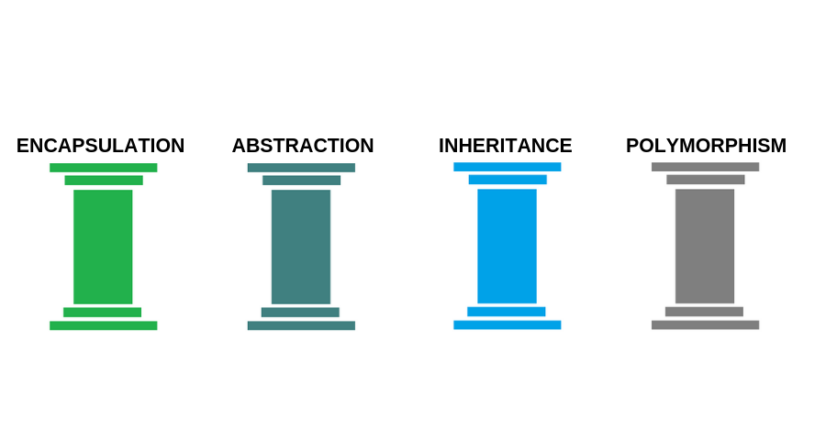
Lecture context
Most programs run in Object Orientated graphical environments these days such as Windows, Mountain Lion, Linux, etc.
Graphical environments are based around a GUI model and all visible items are visual representations of some code that programmers and users can modify and utilise.
These visible items are instances of Classes (sort of a genus name such as ‘birds’) and are called Objects.
They may be manipulated via Properties and Methods by the user or programmer, and it is essential that students are familiar with these concepts before we move onto actual programming.
Notes:
Must remember by heart these 4 points, though not scope of course, you will consciously and subconsiously use this programming paradigm.

Slide 4
Object prefixes
Names must start with a letter (max 255) Capitalise and Prefix object names as follows (assessed):
Prefix | Object | Example use
cbo | Combobox | cboUserChoice
chk | Checkbox | chkUserSelection
cmd | Command Button | cmdStart
dat | Data | datMyDataFile
dir | Directory list | dirUserDirectory
dlg | Common dialog | dlgPrintFile
frm | Form | frmStartupForm
gr | Graphics Object | grForm
txt | Textbox | txtDataEntryBox
btn | Button | btnOk

Slide 5
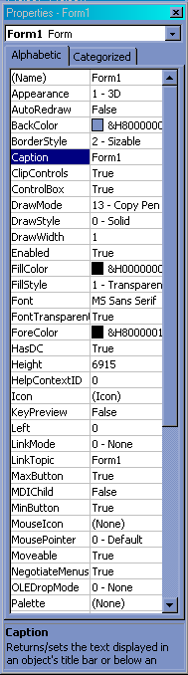
Properties
Set characteristics and/or appearance of an Object (occasionally functionality too)
All Objects support them and expose many to programmer
May be manipulated/set at both DESIGN TIME (when writing code) or RUN TIME (user interaction)
Typical: Size, Colour, Font, Text, Name....
Format is Object.Property
Some properties are read only at run time (e.g. Bold and Italic for Textbox)

Slide 6
General Programming Understanding
Accessing Properties
picPicture1 is a Class / Object in this example
When u use the dot notation, you are accessing the internal variable inside of it
Writing it in this manner would mean assigning the value to the inner variable
Also known as variables in other programming languages
e.g. picPicture1.BackColor = Color.Red
Accessing Methods
picPicture1 is a Class / Object in this example
When u use the brackets at the end u are trying to access a method
Writing it in this manner would mean assigning the value to external variable
Also known as functions in other programming languages
e.g. myResult = picPicture.getColor()

Slide 7
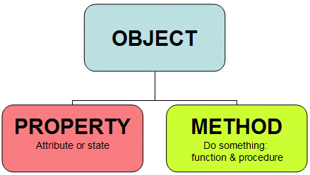
Properties
Name used to access the control’s properties and methods – Design Time ONLY
BackColor background colour for text or graphics e.g. picPicture1.BackColor = Color.Red
ForeColor usually pen or text colour e.g. picPicture1.ForeColor = Color.Black
Text Sets a message in a textbox – or reads text from one e.g. txtTextBox.Text = “Hello World”

Slide 8
Methods
Procedures that operate on an Object
May change the values of Properties
Returns a value and accepts arguments
General format is: Object.Method
Arguments are separated by commas:
E.g. draw a red circle with diameter 100
Dim grForm As Graphics = Me.CreateGraphics()
Dim ellipse_pen As New Pen(Color.Red, 3)
grForm.DrawEllipse(ellipse_pen, 0, 0, 200, 200)

Slide 9
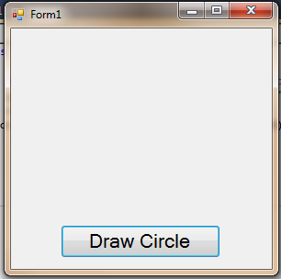
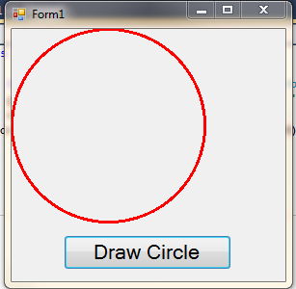
Method Example
Object
METHOD
Looks like a property doesn’t it?
Ellipse(circle) defined in a rectangle with top left coordinates 0,0 and diameter 200
grForm.DrawEllipse(ellipse_pen, 0, 0, 200, 200)

Slide 10
EVENTS
Trigger an object’s reaction to external or internal stimuli
Windows monitors for events and ‘flags’ occurrence to objects – not instantaneous
Response code = EVENT HANDLER
No Event Handler code= no response
e.g clicking the command button runs: Private Sub Button1_Click(ByVal sender As System.Object, ByVal e As System.EventArgs) Handles Button1.Click
“Button1_Click” is just a name,
“Handles Button1.Click”
defines the event it handles
*Note underlined section beyond scope of the module
Notes:
Some of these concepts may be new to you, so will look through the next few slides to understand further.

Slide 11
EVENTS
An event handler may respond to several events which can be very useful
Only the event Handler definitions need modification
These visible items are instances of Classes (sort of a genus name such as ‘birds’) and are called Objects.
E.g. to respond to 3 different button click event calls using a single event handler
Code Example
Private Sub Button1_Click(ByVal sender As System.Object, ByVal e As System.EventArgs)
Handles:
btnButton1.Click,
btnButton2.Click,
btnButton3.Click
Notes:
Some of these concepts may be new to you, so will look through the next few slides to understand further.

Slide 12
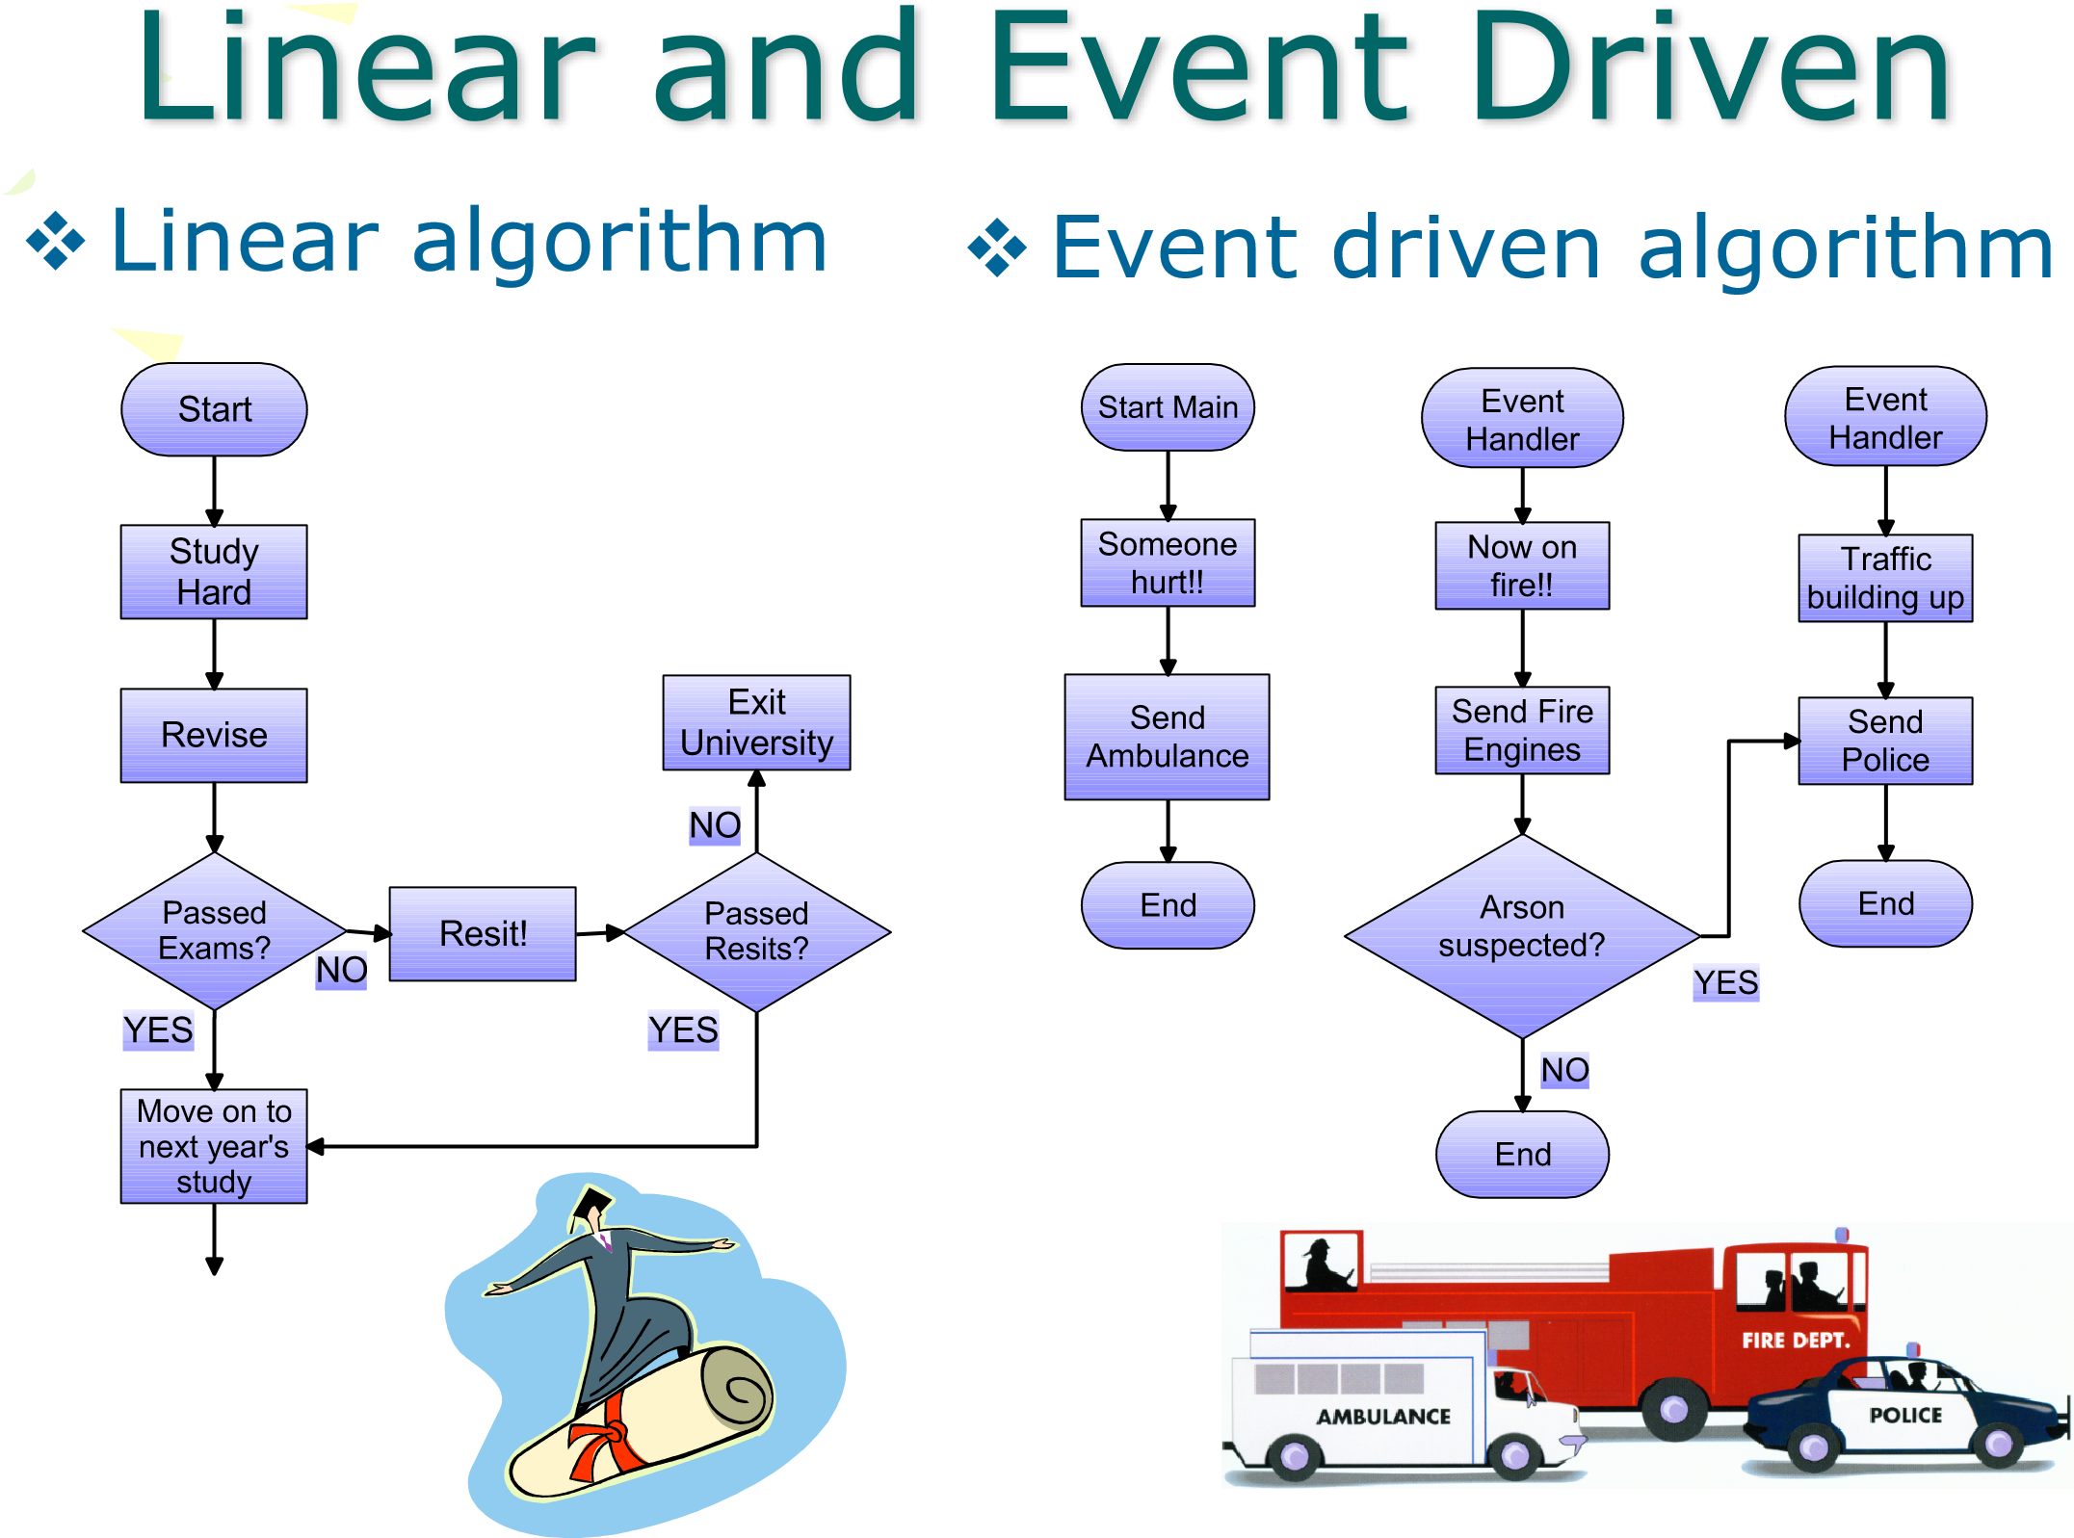
Notes:
Some of these concepts may be new to you, so will look through the next few slides to understand further.

Slide 13
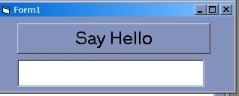
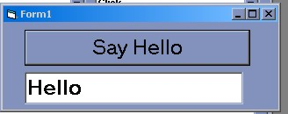
EVENTS AND HANDLERS
Typical events include: Click, Double click, Mouse down/up, Key Down etc...
Event Handler code resides in subroutines
Private Sub Button2_Click(ByVal sender As Object, ByVal e As System.EventArgs) Handles btnSendMessage.Click
txtTextBox1.Text = "Hello"

Slide 14
FORM OBJECT
Basis for most VB apps.
One may have multiple forms in an application
Supports many events
Most important event handler is under the Load Event - run at application startup - initialization of variables and equipment - similar to onInit on other programming languages

Slide 15

TEXTBOX CONTROL
Gather user input or display program output – most applications use Textboxes
Typical properties: dimensions, position, bold, italic, index (control array), password box (******), colour, scrollbars...
Supports MULTILINE property (default=False)
Notes:
If multiline is true, the textbox can be adjusted

Slide 16
TEXTBOX CONTROL
To display text,
set property
To read and store text, equate a
variable to the object’s property
Private Sub Button1_Click_1(…) Handles Button1.Click
txtTextbox1.Text = “Hello World”
End Sub
Private Sub Button1_Click_1(…) Handles Button1.Click
Dim strMyString as String
strMyString = txtTextbox1.Text
End Sub
Notes:
If multiline is true, the textbox can be adjusted

Slide 17
Command button control
Default Event trigger by clicking mouse on button
Typical properties: dimensions, position, bold, italic, index (control array), password box (******), colour, scrollbars...
Supports MULTILINE property (default=False)
Other events: key up, key down, mouse up, mouse down, got focus, lost focus
Methods: Move, refresh, drag, set focus
Private Sub btnCommand1_Click()
v txtTextbox1.Text = “Hello World”
v End Sub

Slide 18
Command button control
Supports many properties: style, back color, captions, down picture, enabled, font, size, position…
Changing color requires style = Graphical
All can be set at design time or dynamically at runtime

Slide 19
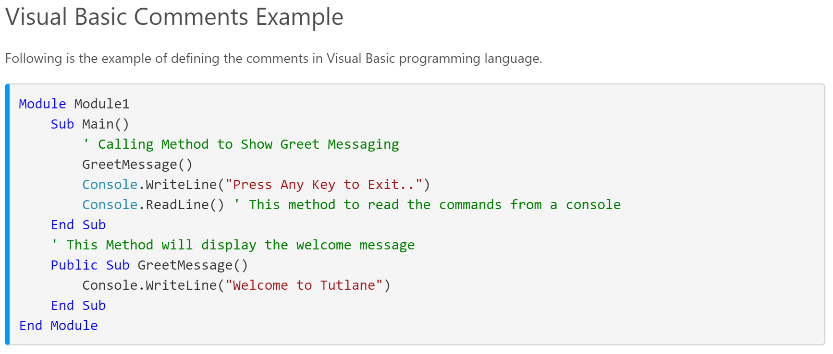
Writing comments in Visual Basic
https://www.tutlane.com/tutorial/visual-basic/vb-comments

Slide 20
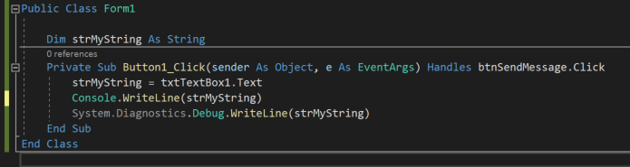
DEBUGGING IN VISUAL BASIC
Use Console.WriteLine(variableName)
Or System.Diagnostics.Debug.WriteLine(variableName)
To debug ur output
In programming languages like python we would use print() to check our output

Slide 21
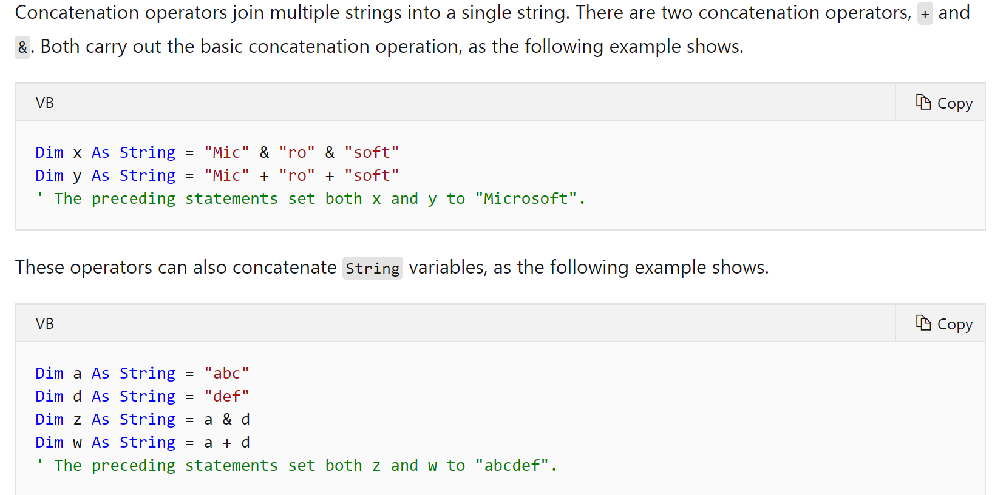
STRING Concatenation in visual Basic
https://docs.microsoft.com/en-us/dotnet/visual-basic/programming-guide/language-features/operators-and-expressions/concatenation-operators

Slide 22

STRING Concatenation in visual Basic
Differences Between the Two Concatenation Operators
The + Operator has the primary purpose of adding two numbers. However, it can also concatenate numeric operands with string operands. The + operator has a complex set of rules that determine whether to add, concatenate, signal a compiler error, or throw a run-time InvalidCastException exception.
The & Operator is defined only for String operands, and it always widens its operands to String, regardless of the setting of Option Strict. The & operator is recommended for string concatenation because it is defined exclusively for strings and reduces your chances of generating an unintended conversion.
Can be written in this manner, example shown below
https://docs.microsoft.com/en-us/dotnet/visual-basic/programming-guide/language-features/operators-and-expressions/concatenation-operators

Slide 23
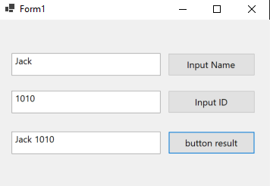
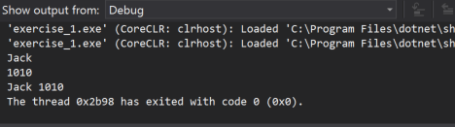
EXERCISE (10 – 15 minutes)
To create a mini application
Input name button on click must print in visual studio output
Input id button on click must print in visual studio output
When I click button result it should print out the name field with a space followed by the ID

